Slide 1
Estonian experience on regulatory and tax policy
Ingmar Kurg NNA Smoke-Free Estonia

Slide 2
Topics
Estonian E-liquids’ tax break
Excise duty on safer tobacco and nicotine products
Flavours of safer tobacco and nicotine products
E-cigarette, tobacco-free snus and heated tobacco user survey 2021

Slide 3
E-liquid tax break
In Estonia, the excise duty rate for e-liquids is 0,2 euros per milliliter.
BUT, in the period 01.04.2021-31.12.2022, e-liquids are not subject to excise duty. WHY?
Legal e-liquids were expensive in Estonia and users began to:
buy e-liquids on the black market,
mix e-liquids themselves,
buy e-liquids from other countries, mainly from Latvia.
According to various estimates, the black and grey market for e-liquids is accounted for 62-80% of the entire Estonian e-liquids market
But why not simply reduce the rate of the excise duty?
The Ministry of Finance said that the revenue wouldn’t cover the costs of collecting tax
Notes:
From a health point of view, it was safest to buy e-liquids from Latvia, because those liquids comply with the rules agreed in the European Union, have been tested in the laboratory, and there is a selection on flavoured e-liquids.
Even if consumer knows how to mix e-liquids and buy the right ingredients, your results are not tested. At the same time this is way you can get the preferred e-liquids much cheaper.
E-liquids purchased from the black market are also not tested and you can not be sure of their origin. In Estonia, it happened that black market sellers and buyers were mainly minors. All the anti-e-cigarette officials, who claimed to protect the children, turned children to black market dealers. If you think all the parents were worried, that was not the case. For some parent it was ok that their child earned his/her pocket money.
The Ministry of Finance said that by reducing the rate of excise duty, the revenue from excise duty would not cover the costs related to the collection of excise duty.

Slide 4
Outcomes of e-liquid tax break
Consumers are certainly pleased that the prices of legal e-liquids are lower
Activity in the black market for e-liquids has decreased
It is cheaper and safer to buy legal e-liquids
“Secret” social media groups selling e-liquids are not that active
As the students were studying at home for a long time, the black market shrank.
Unfortunately, we do not yet have national e-liquid sales numbers.
As e-liquids are on excise duty break, the sales numbers are collected once a year not monthly. We will get an overview of e-liquid sales volumes at the beginning of next year.
Notes:
That’s because schools and hobby schools were one of the main places to sell and buy illicit e-liquids.

Slide 5
Excise duty on tobacco and nicotine products
We believe that excise duty rates on tobacco and nicotine products should depend on harm caused.
The most harmful product would be subject to the highest rate of excise duty.
The rate of excise duty on other products would depend on their harm compared to the most harmful product.
This way we create an economic incentive for users to switch to a less harmful product.
Product | Excise duty rate 2021 | Excise duty rate 2022
Cigarettes | 86,50 euros/1000 pcs + 30% from retail price | 91,30 euros/1000 pcs + 30% from retail price
 | min. 145,60 euros/1000 pcs | min. 152,85 euros/1000 pcs
Cigarillos | 151 euros/1000 pcs + 10% from retail price
 | min. 211 euros/1000 pcs
Cigars | 151 euros/1000 pcs + 10% from retail price
 | min. 211 euros/1000 pcs
Smoking tobacco | 97,10 euros/kilogram | 101,90 euros/kilogram
Solid tobacco substitute | 97,10 euros/kilogram | 101,90 euros/kilogram
Other alternative product | 0,2 euros/gram

Slide 6
Flavours - where there's a will there's a way
In Estonia sales of flavoured nicotine-containing e-liquids are forbidden from 1 June 2019 (except tobacco flavour). The menthol exception was added 1 May 2020.
The closest place to buy flavoured e-liquid that complies with EU Tobacco Directive is Latvia
Where there's a will there's a way:
New stores came on the market that focused on selling liquid food flavourings,
E-cigarette stores began selling liquid flavourings.

Slide 7
Latvia’s plan: a total ban of all flavours!?
Flavourings used in e-liquids are also used in food products which means that flavour ban will not be effective.
Banning flavoured e-liquids will create a new business opportunity resulting in new flavouring stores soon opening in Latvia as well.
What would Latvia like to achieve by banning flavoured e-liquids?
Protect young people? As a result of such bans, young people in Estonia became black market dealers. If Latvia truly wants to protect young people, they should punish those who sell e-cigarettes and e-liquids to them.
Do not deny your adult smokers access to less harmful products that comply with uniformly agreed rules in the European Union and help them quit smoking.
Notes:
Same happened in Finland

Slide 8
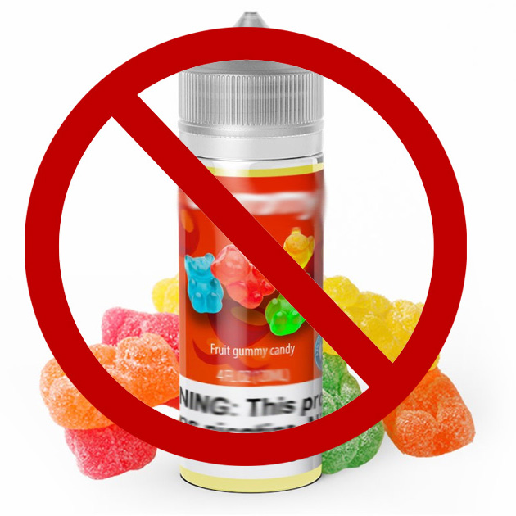
Estonia’s plan: a compromise on flavours
Flavours in ready-made e-liquids in Estonia are currently limited to tobacco and menthol flavour.
A draft law is pending before Parliament: the selection of flavored e-liquids will be extended, whilst flavours described as sweets, candies or soft drinks will remain prohibited.

Slide 9
User survey 2021
NNA Estonia conducted a survey among users of e-cigarettes, tobacco-free snus and heated tobacco.
603 people participated in the study. Most of them had already quit smoking and done so with a less harmful product.
We asked people why they started using less harmful products, what their consumption habits are, and what they think about regulating these products.
The English summary of the study is available on our website nna.ee/en

Slide 10
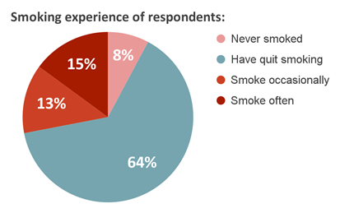
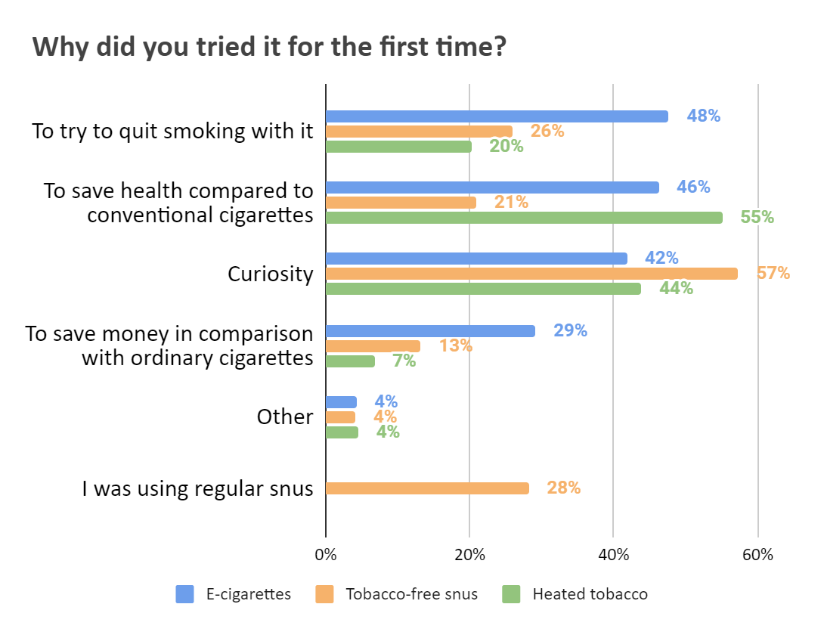
User survey 2021

Slide 11
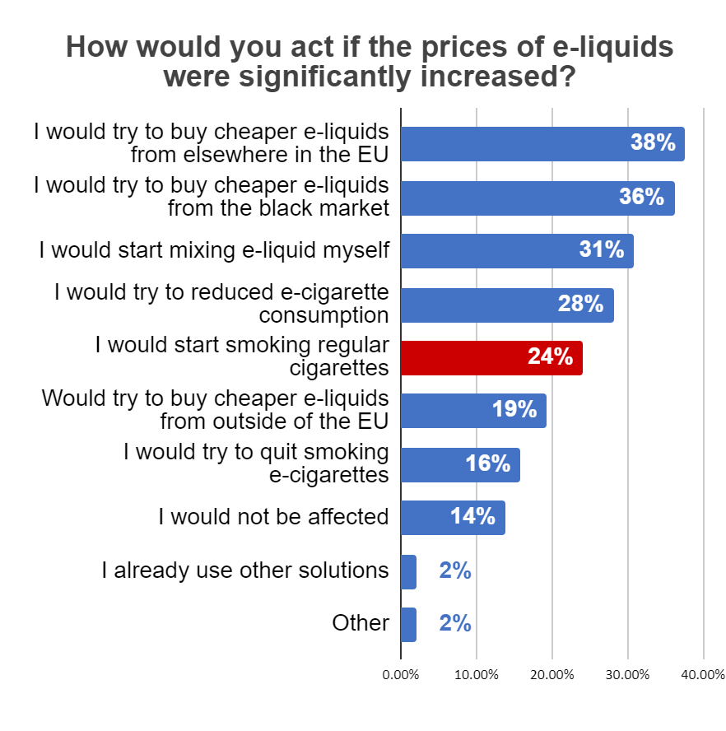
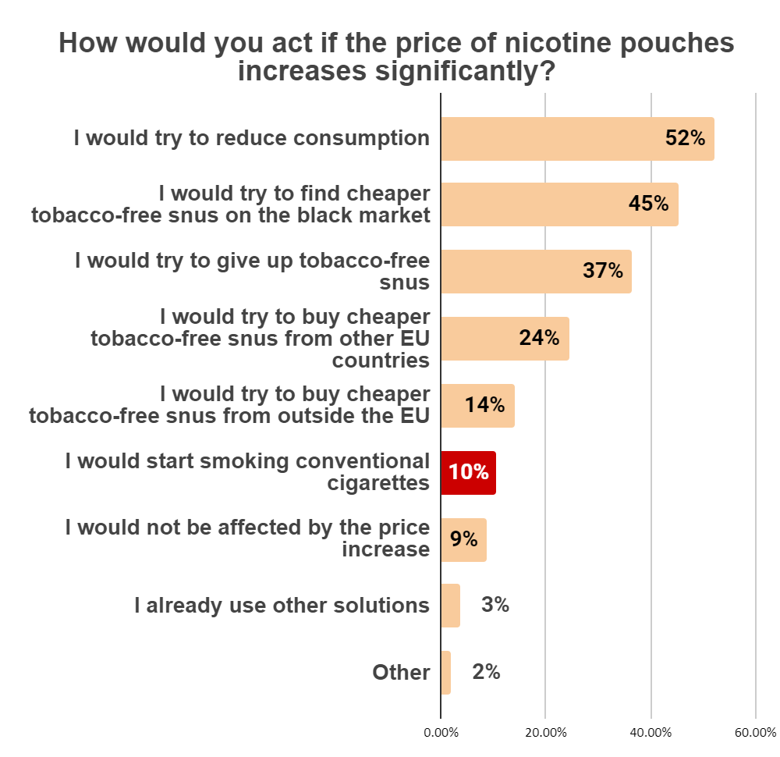
User survey 2021

Slide 12
Thank you!
Questions?

