Slide 1
“A WORLD WITHOUT CIGARETTES”
Nils Erlimo
Communications Director, Swedish Match

Slide 2
Zyn nicotine pouches

Slide 3
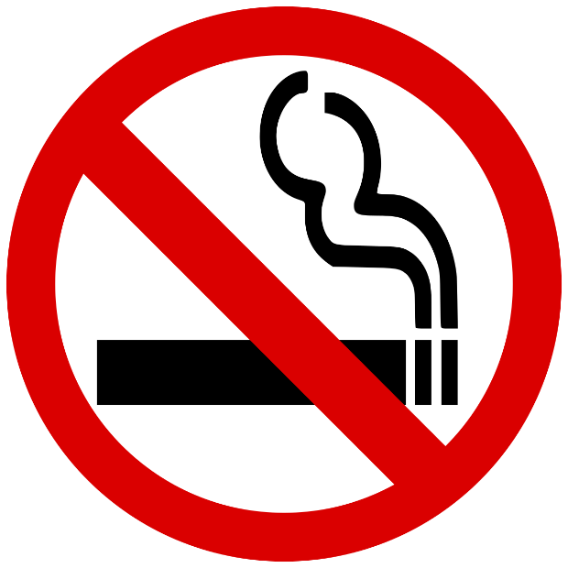
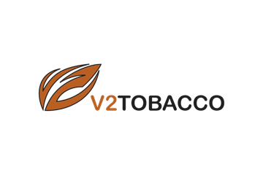
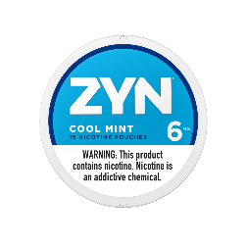
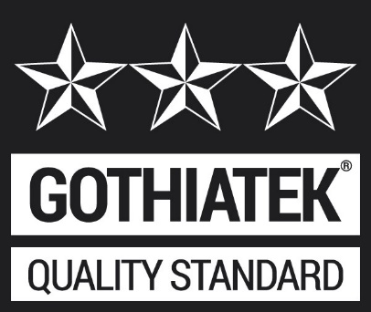
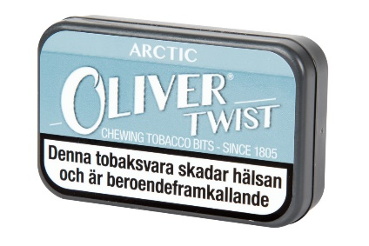
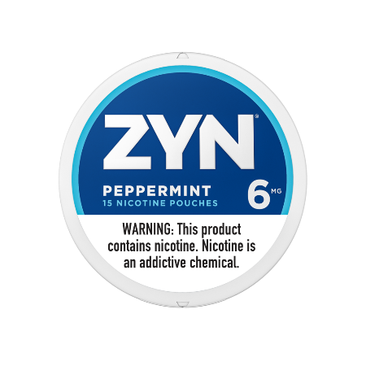
History of strategic transformation
A WORLD
WITHOUT
CIGARETTES
US ZYN National launch
FDA MRTP Designation for General snus in the US
Cigarette operations divested
Pipe tobacco operations in South Africa divested
New Company Vision: A world without cigarettes
Acquired V2 Tobacco (chewing tobacco and snus business)
1999
2009
2014
2017
2019
2000
2010
2016
2018
GOTHIATEK established
Creation of new STG (cigars, pipe tobacco, fine cut tobacco) and simultaneous divestment of Swedish Match premium cigar, European cigar, and pipe tobacco businesses
Reduced shareholding in STG in connection with the listing of STG on Nasdaq Copenhagen; remaining shares sold in 2017
Launch of ZYN nicotine pouches in the US
Acquired Oliver Twist (chewing tobacco business) and 95% of the shareholding in Gotlandssnus (snus business)

Slide 4
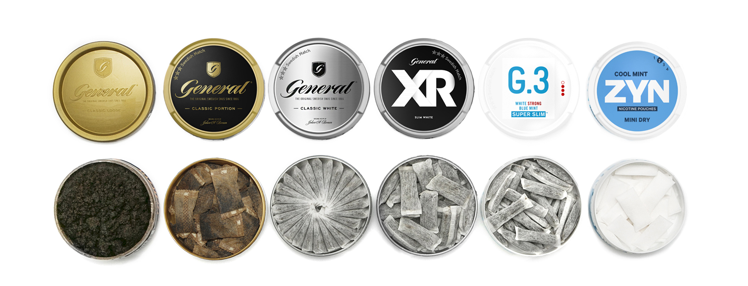
THE EVOLUTION OF SMOKEless PRODUCTS IN SCANDINAVIA

Slide 5
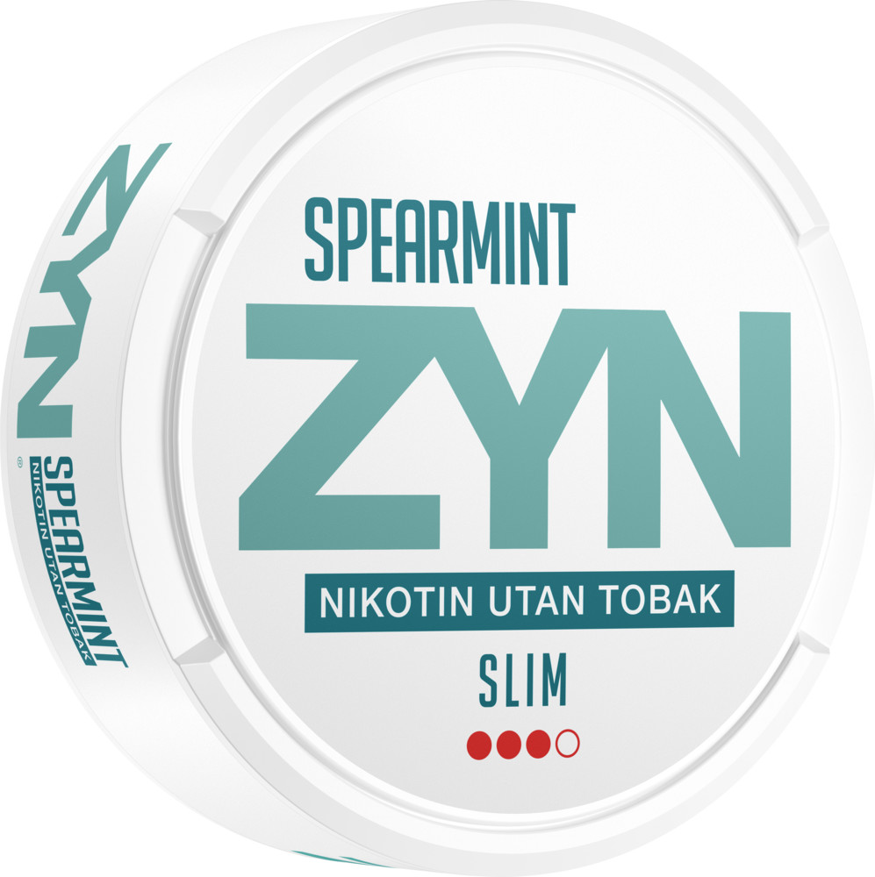
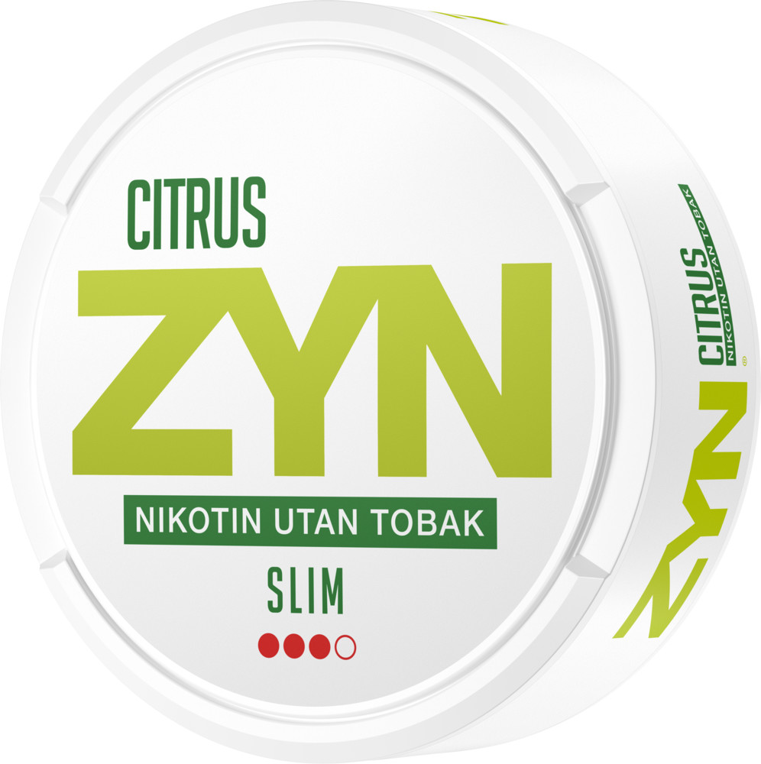
WHAT is ZYN?
ZYN is a consumer product for oral use containing nicotine but no tobacco.
ZYN does not require inhalation of smoke or vape.
ZYN is a pouched product, comes in a variety of flavors and nicotine strengths.
ZYN is placed under the upper lip and is “spit-free”.
ZYN does not contain detectable levels of tobacco specific nitrosamines (NNN, NNK) or Benzo (a) pyrene
The nicotine in ZYN is absorbed to the blood through the oral mucous membranes.
The target audience of ZYN is adult users of combusted and non-combusted tobacco products.
Nicotine pouches is NOT regulated by EU.

Slide 6
Myths about nicotine pouches
Myth 1:
One box of nicotine pouches has 16,8 gr of product, with a nicotine concentration of 14 mg/g = contains 235,2 gr nicotine and corresponds to almost 12 packs of cigarettes.
Not true. Calculation error: a pack of NPs has approx. 230 MG (not Gr) of nicotine.
A pack of cigarettes contains approx. 240 mg of nicotine
Cigarettes are known to contain 12 to 24 mg of nicotine, and the law sets a maximum nicotine emission of 1 mg per cigarette. In contrast, a typical nicotine pouch can contain only 1,5 to 12,8 milligrams of nicotine.
Myth 2:
Flavours leads young consumers into the category
Not true.
The age limit is absolute
Based on Norwegian and Swedish consumers: flavors are more attractive for smokers.

Slide 7
Smoking is the problem

Slide 8
2.1.2. The role of tobacco in the society
Tobacco is a legal product on the EU’s internal market, but is no ordinary commodity in the sense that it is the largest avoidable health threat in the EU, responsible for almost 700,000 deaths in the EU each year.
- European Commission
Source: https://ec.europa.eu/health/sites/default/files/tobacco/docs/com_2012_788_ia_en.pdf

Slide 9
Innovation increasingly seen as part of the solution
“Where users have a range of options to similar functional effects, regulation should facilitate transitions to nicotine options with reduced risk”
Royal College of Physicians UK (2016)
“We will help people quit smoking by permitting innovative technologies that minimize the risk of harm. We will maximize the availability of safer alternatives to smoking”
UK Department of Health (2017)
“A renewed focus on nicotine. Adults who still need or want nicotine can get it from alternative and less harmful sources. FDA stands ready to do its share.”
FDA (2017)

Slide 10
Smoking comparison

Slide 11
Smoking in latvia
Source: https://www.spkc.gov.lv/lv/media/15536/download

Slide 12
Tobacco habits in Sweden and Norway 2020
Source: Statistics Norway.
Notes:
Source: https://www.ssb.no/helse/helseforhold-og-levevaner/statistikk/royk-alkohol-og-andre-rusmidler

Slide 13
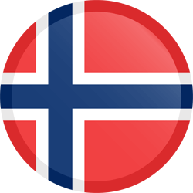
Daily use of tobacco in Norway
Men, age 16-24
Women, age 16-24
Oral nicotine
Oral nicotine
Cigarettes
Cigarettes
Source: Statistics Norway.
Notes:
Data from Statistics Norway

Slide 14
Swedish men is proof of concept
Source: GLOBOCAN 2012, IARC -26.6.2014.

Slide 15
Smoking and degree of regulations (2017)
Prevalence of smoking
Greece
France
Spain
Germany
Denmark
Finland
Ireland
GB
Norway
Strictness of regulation
Source: Source: Tobacco Control Score 2016 and Eurobarometer, March 2017
Source: Tobacco Control Score 2016
Eurobarometer, March 2017
Notes:
Kilde: Tobacco Control Score 2016
Eurobarometer, mars 2017

Slide 16
Harm reduction equation
Harm reduction = Reduced risk x Number who switch
Trade offs
Conclution 1: The perfectly risk free product that no-one wants scores badly in the harm reduction equation.
Conclution 2: A diverse range of products with substantially reduced risk lets each smoker decide wich product is best

Slide 17
What has driven this change away from cigarettes?
Main reasons
Less dangerous products have been in the market for a long time, and have had the possibility to compete with traditional cigarettes.
Culturally driven – smokers see products as an alternative
«everybody knows» that nicotine pouches and other oral products are less dangerous than cigarettes. However, they still think it is more dangerous than it is.
Consumer driven change
Fueled by media and Norwegian scientist
Market has allowed for it to happen
No bans, but strict regulations
Harm reduction (small) part of policy
Politicians not in the front seat

Slide 18
Regulations for Oral Nicotine (a simplification)
what | Sweden | Norway | Czech Republic | Estonia | Denmark
Display ban | no | Yes | No | Yes | Yes
Taxation (RSP) | Half tax for NPs compared to oral tobacco | Half tax for NPs compared to oral tobacco | No | Yes, as alternative tobacco product | legislation in preparation
General knowledge about NPs | High | High | Medium | Medium (increasing) | Medium
Media discussion on harm reduction | Yes | Yes, frequently | Yes, but not mainstream | Rarely | few examples in specialized media
Nicotine ceiling | Recommended by Swedish Institute of Standards (20 mg/pouch). Supported by industry. | No | No, but will be addressed during by the MoH once work on secondary reg. commence | No | No
Plain pacs | No | Probably | No | No | No
Licensing for sale | No, but expected | Yes | No | Yes | No
18 year limit | Yes | yes | Yes | Yes | Yes
Flavours | Yes | Yes | Yes | Yes | Yes

Slide 19
Danish Health Authorities
Nicotine Pouches. Legal in Denmark. Sold in a can and looks like snus. The difference is that there is no tobacco in the product, and that it is not carcinogenic. But it is addictive.
Source: Danish Health Authorities in media on Sept 8th.

Slide 20
how to use Nicotine pouches in fighting smoking
Let the market do the job
Harm reduction products can (and will) help people to quit smoking, if provided commercial opportunity
Keep harm reduction products away from minors
Licensing, age limit – strict rules for those selling
Keep the flavours and attractiveness of alternative nicotine products
Flavours will help more people switch from smoking
Nicotine is important for consumers
Nicotine ceiling at 20 mg/pouch will be sufficient for consumers and at the same time hinder super strong products from entering the market.
Don’t make harm reduction the enemy, even if people start using the products
That will only benefit traditional cigarettes. For those unwilling or unable to quite using nicotine, alternative reduced risk products is better |xthan continue using combustible products.

