Slide 1
SMOKE FREE PRODUCTS: A BETTER ALTERNATIVE TO SMOKING?
September 15, 2021
Felicetta Catanzaro, Head of Scientific Engagement - EU
Philip Morris International

Slide 2
Objective of Harm Reduction
Tobacco Harm Reduction
Smoking-Related Diseases
Smoking is addictive and causes a number of serious diseases
1
1,000,000,000
Number of Smokers
Estimated that more than 1 billion people worldwide will continue to smoke in the foreseeable future*
2
3
Smoke-Free Alternatives
Offering smoke-free alternatives to adult smokers is a sensible, complementary addition to existing tobacco control strategies
Source: (*) WHO global report on trends in tobacco smoking 2000-2025 (Accessed: April 10, 2021)
Notes:
What HR is exactly?
This template was inserted from Power-user, the productivity add-in for PowerPoint, Excel and Word.
Install Power-user to access thousands of templates, icons, maps, diagrams and charts with Power-user.
Visit https://www.powerusersoftwares.com/
©Power-user SAS, terms of license: https://www.powerusersoftwares.com/terms

Slide 3
Population Harm Reduction
Population Harm Reduction
Individual Risk Reduction
Smokers
Switching
Successful Harm Reduction Requires Current Adult Smokers be Offered a Range of Reduced-risk Products so that Consumer Acceptance Can be Best Fulfilled
Source: Figure is adapted from Clive Bates presentation to E-Cigarette Summit (19 Nov 2013)

Slide 4
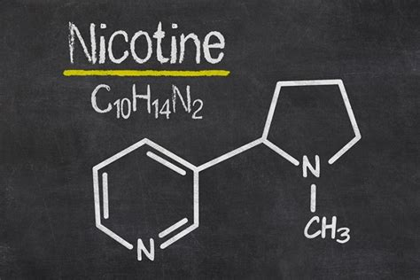
Nicotine is not the Primary Cause of Disease
Nicotine … is not what makes tobacco use so deadly.
Tobacco and tobacco smoke contain thousands of chemicals. It is this mix of chemicals—not nicotine—that causes serious disease and death in tobacco users, including fatal lung diseases, like chronic obstructive pulmonary disease (COPD) and cancer.
US FDA Website (Accessed: April 10, 2021) .
Nicotine, though addictive and not risk-free, is not the primary cause of smoking-related diseases
4 out of 10 smokers and ex-smokers wrongly think nicotine causes most of the smoking-related cancers, when evidence shows nicotine actually carries minimal risk of harm to health.
Public Health England Website (Accessed: April 10, 2021)

Slide 5
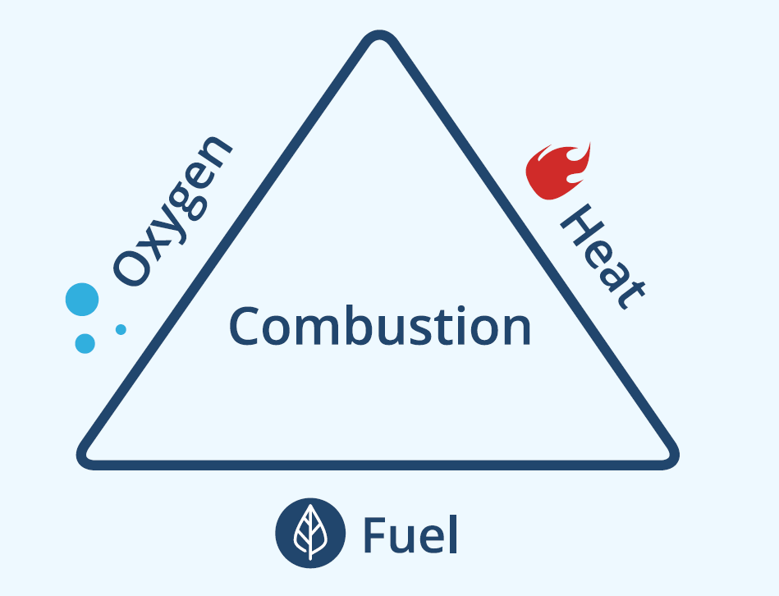
Understanding Combustion
Ignition
Fuel
(Tobacco)
Oxidizer
(O₂ in air)
Energy
(Heat & Light)
Smoke & Ash

Slide 6
PMI’s Smoke-Free Product Portfolio
Our Objective is to Offer Adult Smokers Who Would Otherwise Continue to Smoke Reduced-risk Products They Could Completely Switch to
Heated Tobacco Products
Products Without Tobacco
PLATFORM
PLATFORM
PLATFORM
PLATFORM
1
2
3
4
Electrically Heated Tobacco Product (eHTP) or Tobacco Heating System (THS)
Carbon Heated Tobacco Product (cHTP)
e-Vapor Products
e-Vapor Products
Note: The products depicted are subject to ongoing development, and, therefore, the descriptions are illustrative and do not necessarily represent the latest stages of product development.
Notes:
…. Currently in PMI we are working to develop 4 different platforms.
Two of them, P1 and P2, contain tobacco however tobacco is heated and not burned. And the other 2, P3 and P4, deliver nicotine but do not contain tobacco.
Today we will be reviewing the scientific evidence behind our platform 1 which heats tobacco electronically without burning it.
As a company we have made huge investments to design, develop a product portfolio to provide current ADULT smokers Who Would Otherwise Continue to Smoke with smoke-free Products.

Slide 7
Population Harm Reduction
Population Harm Reduction
Individual Risk Reduction
Smokers
Switching
Successful Harm Reduction Requires Current Adult Smokers be Offered a Range of Reduced-risk Products so that Consumer Acceptance Can be Best Fulfilled
Source: Figure is adapted from Clive Bates presentation to E-Cigarette Summit (19 Nov 2013)

Slide 8
PRODUCT-SPECIFIC TOBACCO HEATING SYSTEM (THS) SCIENCE
Aerosol Chemistry, Clinical studies, Post-Market Studies

Slide 9
Totality of Scientific Evidence
Post-Market Studies & Surveillance
Population Harm
Consumer Perception & Behavior
Reduced Exposure
& Risk
Clinical Studies
Systems Toxicology
Reduced Risk
(in animal models)
Standard Toxicology
Reduced Toxicity
Aerosol Chemistry & Physics
Reduced Formation
Product Design & Control Principles
Source: Smith (2016) Regul Toxicol Pharmacol, 81 Suppl 2:S17-S26 (DOI:10.1016/j.yrtph.2016.07.006)

Slide 10
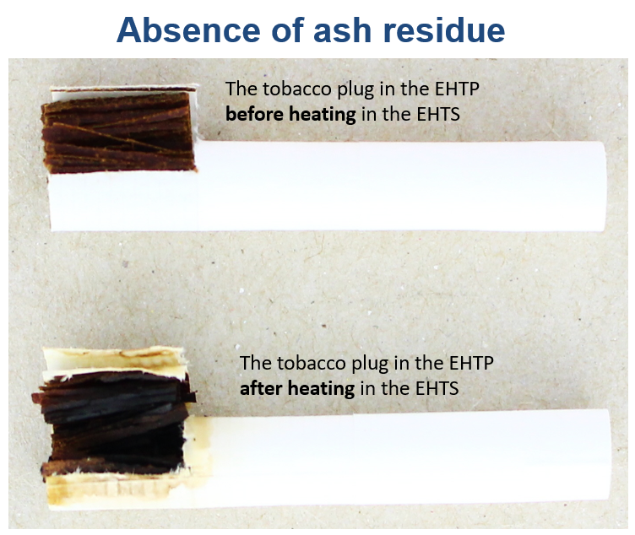
Absence of Combustion in THS
Operating THS in oxidative (air) or in non-oxidative (nitrogen) atmosphere
Absence of ash residue
Average maximum temperature below combustion

Slide 11
The Difference Between THS Aerosol & Cigarette Smoke
Aerosol Chemistry & Physics
Water and glycerin form 50% of smoke mass
Water and glycerin form 90% of aerosol mass
Toxicants
Toxicant levels reduced by >90%
Does not generate carbon-based solid particles
Generates carbon-based solid particles
Free radicals
Free radicals are not quantifiable
Smoke and Aerosol Were Collected on a Cambridge Filter Pad in Accordance with the Health Canada Intense Smoking Regimen
THS = Tobacco Heating System
Source: Ghosh (2014) Beiträge zur Tabakforschung/Contributions to Tobacco Research., 2014;26(2):38-49

Slide 12
Reduced Formation of Toxicants
Aerosol Chemistry & Physics
Average Reduction in Formation of Harmful or Potentially Harmful Constituents with THS Relative to the Levels Measured in Smoke from the 3R4F Reference Cigarette by Disease Category*
Reference
Cigarette
THS
Air
Number of Toxicants | 17 | 94 | 12 | 45 | 11
THS = Tobacco Heating System; Health Canada’s Intense Smoking Regime; Comparison on a per-stick basis (excluding nicotine)
*Analysis of the FDA-93 Harmful or Potentially Harmful Constituents included more than 93 individual compounds because the FDA-93 includes some classes or isomers

Slide 13
Reduced Exposure
Clinical Assessment (in Smokers Who Would Otherwise Continue to Smoke Cigarettes)
HPHCs Are Drastically Reduced in THS Aerosol
Exposure is Significantly Reduced
After Switching to THS
Cigarettes
THS
Smoking Abstinence
Leads to
- 98.6%*
Days (ZRHM-REXA-08-US)
SURGEON GENERAL’S WARNING: Cigarette Smoke Contains Carbon Monoxide.
REMOVED
Source: Haziza (2019) Nicotine & Tobacco Research, 2020, 539–548 (DOI: 10.1093/ntr/ntz013)

Slide 14
Reduced Exposure
Clinical Assessment (in Smokers Who Would Otherwise Continue to Smoke Cigarettes)
Cigarettes
Percent of Cigarette Exposure
[95% CI]
Switching to THS Achieves Almost 95% of the Reduction Achieved by Smoking Abstinence
Cigarettes
Percent of Cigarette Exposure
[95% CI]
THS
Smoking abstinence

Slide 15
Exposure Response Study: Biomarkers of Potential Harm (BoPH)
Clinical Assessment (in Smokers Who Would Otherwise Continue to Smoke Cigarettes)
Co-Primary Endpoints Representative of Pathomechanisms
Epidemiologic link to smoking-related disease?
Affected by smoking status
Reversible upon smoking cessation
Lipid Metabolism
HDL–C
Clotting
11–DTX–B2
Endothelial Function
sICAM–1
Oxygen Delivery
COHb
Inflammation
WBC
Smoking Cessation
Oxidative Stress
8–epi–PGF2α
Assess Changes Across a Set of “8 Co-primary Clinical Risk Endpoints” in Smokers Who Switch from Smoking Cigarettes to Using THS As Compared to Those Continuing to Smoke Cigarettes for 6 Months
Lung Function
FEV₁ %pred
Genotoxicity
Total NNAL

Slide 16
Exposure Response Study: Change in BoPH (over time)
Favorable Changes in BoPH Associated with CVD in Smokers Who Switch to THS Compared to Continued Smoking
Clinical Assessment (in Smokers Who Would Otherwise Continue to Smoke Cigarettes)
Inflammation
Endothelial Function
Oxidative Stress
Oxygen Delivery
Lipid Metabolism
Lung Function
Clotting
Carcinogenicity
Relative Reductions
(THS vs. CC) [% (95% CI)]
THS-CC Difference
[% (95% CI)]
*
*
*
*
*
Month:
3
6
12
3
6
12
3
6
12
3
6
12
3
6
12
3
6
12
3
6
12
3
6
12
Month:
HDL-C
(mg/dL)
WBC
(GI/L)
FEV₁
(% pred)
s-ICAM-1 (mg/dL)
11-DTX-B2 (pg/mg_{CR})
8 epi-PGF2a (pg/mg_{CR})
COHb (%)
Total NNAL (pg/mg_{CR})
Source: ZRHR-ERS-09-US 12-month extension study (NCT number: NCT02649556)

Slide 17
Population Harm Reduction
Population Harm Reduction
Individual Risk Reduction
Smokers
Switching
Successful Harm Reduction Requires Current Adult Smokers be Offered a Range of Reduced-risk Products so that Consumer Acceptance Can be Best Fulfilled
Source: Figure is adapted from Clive Bates presentation to E-Cigarette Summit (19 Nov 2013)

Slide 18
Do smokers switch to less harmful products?
Japanese Adult (≥ 20 years) Tobacco Use Prevalence
By Pattern of Use
Japanese National Health and Nutrition Survey
HTPs
Survey Updated
+70%
Total Tobacco
Cigarettes (only)
Heated Tobacco (only)
Dual Use (Cigarettes + Heated Tobacco)
Other
Source: National Health and Nutrition Survey, Japan (2020)

Slide 19
Study results | History of Tobacco Nicotine Products (TPN) use (2019)
IQOSTM USERS SURVEY
First TNP Ever Used (%)
n = 1,971
n = 1,249
n = 1,358
>99% of current IQOS users initiated regular TNP use with a product other than IQOS
Source: P1-PMX-01-JP, P1-PMX-02-IT, P1-PMX-03-DE

Slide 20
Youth and never-smoker initiation of IQOS
Prof. Yoneatsu Osaki “Nationwide survey on smoking and drinking behaviors” shows low youth initiation to heated tobacco products, no “gateway to smoking” for younger generation.
BZgA “Alcohol survey 2019 and trends” shows heated tobacco products are not initiation products for minors.
Addiction Suisse “Health Behavior in School-aged Children” shows low youth use of heated tobacco products.
The U.S. FDA, in its decision on IQOS commercialization in the U.S., concluded based on PMI’s data from Japan, Italy, and the U.S. that “Available data, while limited, also indicate that few non-tobacco users would be likely to choose to start using IQOS, including youth.”
Notes:
Independent studies and national surveys have reported very low initiation

Slide 21
Product use in summary
1
Uptake of heated tobacco products is mainly in the adult smoker populations
The majority of Heated Tobacco Product users no longer smoke cigarettes
2
Non-smokers and ex-smokers rarely initiate tobacco or nicotine use with the HTP
Almost every user of the heated tobacco product has a history of tobacco or nicotine use
3
Published literature indicates a low prevalence of heated tobacco product use in youth

Slide 22
OTHERS HAVE A ROLE: GOVERNMENTS

Slide 23
Regulation to support switching
REGULATION TO SUPPORT SWITCHING
SWITCHING
COMPLETELY
Access
Awareness
Acceptability

Slide 24
FDA’S MRTP ORDER FOR IQOS - 7 July 2020
Data submitted by the company shows that marketing these particular products with the authorized information could help addicted adult smokers transition away from combusted cigarettes and reduce their exposure to harmful chemicals, but only if they completely switch.
Mitch Zeller, Director FDA Centre for Tobacco Products

Slide 25
Conclusions
Conclusions
Are smoke-free products a better alternative to cigarettes?
The totality of evidence, demonstrates that switching to THS completely, while not risk-free, is a better choice for adults who would otherwise continue smoking
The U.S .FDA authorized the commercialization of THS as a Modified-Risk Tobacco Product with reduced-exposure claims, stating that commercializing the product with such information is expected to “promote public health.”
Acceleration of smoking decline in Japan since introduction of HTPs in the market in 2015
Use patterns according to national surveys inform that the product in used as intended
Continuous monitoring of product use will help avoiding unintended consequences
Notes:
I believe these developments are very promising and I want to conclude saying that I am feeling confident saying that Smoke-free products are better alternatives to cigarettes FOR ADULT SMOKERS and have the potential to improve public health. THIS HOWEVER IN MANY COUNTRIES NEED A DIFFERENT APPROACH from regulators, public health experts and society in general. An approach that embraces harm reduction in tobacco control and accepts to role scientifically substantiated better alternatives can play in accelerating the end of cigarettes.

Slide 26
THANK YOU FOR YOUR ATTENTION.
Questions?
Answers.

