Slide 1
UK Vaping Industry Association
The UK’s largest trade body for the vaping sector
UK Overview 2021

Slide 2
Who are the UKVIA?
The UK Vaping Industry Association is the leading trade association for the vaping industry.
We formed in September 2016 and represent the whole breadth of the vaping industry; including manufacturers, retailers, wholesalers, distributers and compliance specialists.
Our 64-strong membership includes representatives from independent stores and brands to more established corporate brands (including tobacco and pharmaceutical company owned brands). We represent roughly 70% of the UK market by volume.
We provide an important interface between the industry and government, regulators, the media and public at large.
We are an open, democratic organisation working to represent the interests of the whole vaping industry. We aim to convince the remaining 7m smokers in the UK to consider switching to vaping.

Slide 3
Market Snapshot 2021
Overview
The UK is Europe's largest vaping market;light touch regulation developed by the UK government encouraged growth.
No tax is applied to vaping
Vape shops have been greatly affected by lockdown which closed them to the public causing some to close.
Pre-filled pod products have become more popular and there is an increasing number of disposable brands entering the market in 2021.
Iqos and ploom are available but have limited uptake accounting for 2.2% of the tobacco market.
Adult vaping population
3,500,000
(7% of 18+ pop
65%
55%

Slide 4
Market Snapshot 2021
There are around 2,800 – 3,000 vape shops in the UK (E-500 since 2019

Slide 5
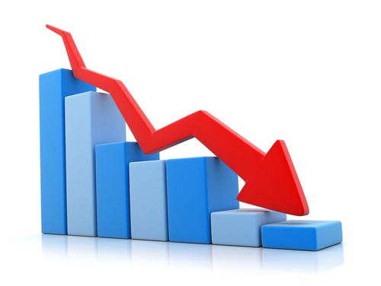
Perception of the industry in 2021
The bad news
Vaping still has an ongoing perception problem – aggravated by flavour bans in a number of key markets, scare stories around Covid and illegal THC/Vit E Acetate usage in the US.
According to the latest ASH figures, there are some 3.5m vapers in the UK, but 7m people are still smoking.
Perceptions of the harm caused by vaping compared with smoking are increasingly out of line with the evidence and rising. The STS survey found that:
29% of current smokers believed vaping was less harmful than smoking
38% believed vaping was as harmful as smoking
18% did not know whether vaping or smoking was more harmful
15% of smokers believed vaping was more harmful than smoking
There is continuing alarm in the media and public mind that young people may take up vaping despite very low youth uptake of vaping in the UK. Some new non-compliant disposable brands using inappropriate marketing may be adding to this issue.

Slide 6
Where is the industry in 2021?
The bad news – regulation:
The current regulatory framework fails to reflect the public health potential of vaping
Thanks to Article 20 of the Tobacco Products Directive:
Packaging restrictions on vaping products are more stringent than those for many hazardous products, including bleach.
There are arbitrary, non-evidence based restrictions on bottle sizes and nicotine strengths.
An unregulated market for ‘short-fills’ has been created.
Advertising regulations continue to create confusion and prevent the industry communicating the public health potential of vaping to consumers.
WHO ignoring the science and taking a prohibitionist like stance on vaping.

Slide 7
Where is the industry in 2021?
Reasons to be cheerful – government & public health community
We have arguably the most supportive public health community in the world – not only through research but through advocacy – Public Health England, Cancer Research UK, Royal Society of Public Health, Action on Smoking and Health, British Society of Psychology to name but a few
Public Health England endorsed vaping starting in its 2018 Stoptober campaign, leading to a substantial boost in trade as reported by our Members
A seminal detailed report on vaping from the Science & Technology Committee made a powerful case for the wider support of vaping and a roadmap to more sensible policy. Which lead us to creating our Blueprint for Better Regulations.
We also work closely with the All Party Parliamentary Group on Vaping and its Secretariat. The APPG is solely focused on vaping policy and evidence and is chaired by Mark Pawsey, MP.

Slide 8
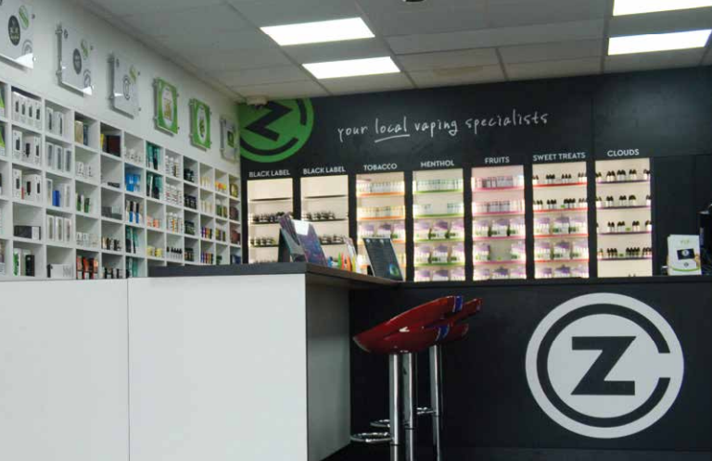
Where is the industry in 2021?
Reasons to be cheerful – the industry
Despite of the pandemic we have a strong industry - the vaping sector now has an estimated up to 3,000 stores, with more opening every week.
Beige Market Intelligence suggests that the UK vaping market could be worth more than a billion pounds in the next few years
Brexit will allow the UK the opportunity to create its own regulations which could see the easing of some of the elements of the TPD/TRPR. A review is currently underway.

Slide 9
#VapingMatters Campaign
October 2019 – April 2020
Advertising campaign highlighting the potential impact of continued vaping misinformation on return to smoking/transition to vaping.

Slide 10
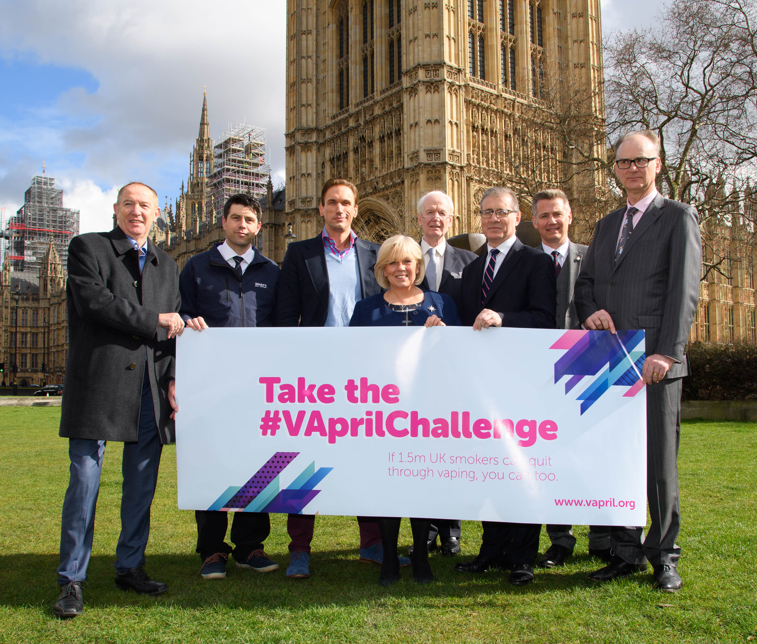
What is all about?
Launched in 2018; the vaping sector’s only dedicated education and awareness campaign to encourage smokers to make the transition from conventional to vaping
Despite lockdowns VApril 2019 & 2020 were a great success; reaching out to millions of people globally via mainstream and social media and support from our international partners around the globe.

Slide 11
Contact information Website : www.ukvia.co.uk John Dunne – Director UKVIA John@ukvia.co.uk

